Slide 1

Super Team or Super Dream?
Conor Klaers and Jade Gosar

Slide 2
Notes:
Andre Iguodala, Kyle Lowry, Dwight Howard, Carmelo Anthony, Andre Drummond, and Zach Lavine

Slide 4
Overview
Overview
Problem
Predict team wins using player data from updated rosters
Solution
Insights
The Lakers are a super team and Westbrook is going to be a difference maker
Average points, opponent team blocks, and team defensive stats have biggest impact on point differential in XGBoost model
Assess the likely impact a given traded player will have on a game’s and season’s outcome
Create bagging model based on game outcome and XGBoost on point differential
Create model that allows for individual-level statistics of traded players to be factored into team success predictions
Team blocks, points scored, and defensive stats such as points allowed are best predictors for game outcome

Slide 5
Data Description/Pre-processing
Data Description/
Pre-processing
Source: nbastatR package
Pulled game data from the 2019-2020 and 2020-2021 seasons
Extracted and calculated offensive and defensive averages based on previous games played
Removed each team's first game of the year to omit NA's for modeling
Built a model to predict a game's point differential
Built a model to replace individual players

Slide 6
Random Forest
Models
Predict Win or Loss
Accuracy: 0.5872
Sensitivity: .5845
Specificity: .5897
Team blocks, average points scored for both teams, and team defensive stats such as field goal percentage against and points allowed have the biggest impact on whether a team wins or loses the game

Slide 7
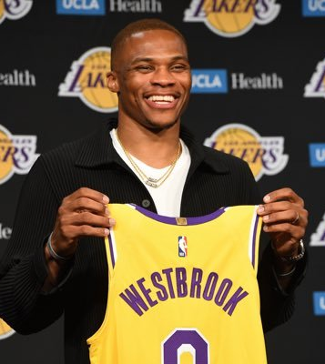
Player Evaluation
Replaced an average player (KCP) with Westbrook
Created predictions for Lakers games with original roster and then Westbrook replacing KCP against final XGboost model
Compared predictions on point difference and outcome on a per game basis
Notes:
LAL expects to bet Nuggets 5/7 times ):

Slide 8



Lakers with KCP
Lakers with Westbrook
Win Percentage in 2020: .6596
Predicted wins in 2021: 41
Win Percentage in 2021: .5775
Win Percentage in 2020: .7234
Predicted wins in 2021:
47
Win Percentage in 2021: .6620
Notes:
Actual wins in 2021: 42
Actual win percentage 2021: .5915
Sportsbooks predictions for 21-22: 51.5 wins
Our predictions for 21-22 based on win percentage of Lakers w/ Westbrook from 2021: 54.3 wins

Slide 9
Conclusions
In random forest, team blocks, average points, and team defensive stats such as points allowed and field goal percentage against are most important predictors
XGBoost model shows that average points scored, opponent team blocks, and team defensive stats are most important predictors for point differential
Russell Westbrook likely will have the largest positive impact of traded players on the Lakers this upcoming season
Model that predicts impact a specific player will have on team seems to be more accurate than XGBoost model

Slide 10
Future Work
Our Model updates automatically and can be easily adapted and applied to future seasons
Apply player evaluation model to all traded players to predict ones that will have the most impact on their teams
Manipulate model to factor in that players may get significantly less time and would need their stats lowered to match new expected minutes played

